Slide 1

Exploring Novel Regulators in Nitrate Signaling
Kun-hsiang Liu
College of Life Sciences
Northwest Agriculture and Forestry University
Department of Molecular Biology
Massachusetts General Hospital
Notes:
My research is mainly focused on nitrate signaling. Today I would like to share with you our finding that we discovered the Ca signal in nitrate signaling and we have generated calcium rationmetric sensors for detecting nitrate & ABA-triggered ca2+ dynamics in Arabidopsis.

Slide 2
Nitrate Is a Nutrient & a Signaling Molecule
-
Gln
NH₄⁺
NO₃⁻
Signaling molecule
NO₃⁻
Nitrate response genes
(NIR, NIA1, NIA2, NRT2.1….)
Hormones
Shoot & root development
Reproduction
KCl Gln NH₄⁺ NO₃⁻
Nitrate assimilation

Slide 3
Three Fates of Nitrate
Nucleus
NO₃⁻
Vacuole
Leaves
Nitrate response gene
Plant development
CLC
Amino acids
Sensor
Plastid
GLN
TF, PK & MicroRNA
NIR
GS
NO₂⁻
NH₄⁺
NO₃⁻
NR
NO₂⁻
CHL1
Sensor
Roots
NO₃⁻
NRT
NO₃⁻
Soil
Notes:
In the past two decades, structure genes involved in nitrate assimilation pathway have been well-studied. However, little is know how does cell sense nitrate and which components are involved in nitrate signaling to turn on nitrate responsive genes expression or modulated plant growth. In order to unveil nitrate signaling, I used functional genectics intergrate genetic approach to explore the components involved in nitrate signaling.

Slide 4
Dissecting Nitrate Signaling in Arabidopsis
NO₃⁻
Genomics
Transcriptome analysis
Genetic Screens
Proteomic analysis
?
CHL1
Transcription factors
NLP7
LBD37/38/39
HRS/HHO
NRG2
NAC4
ANR1
NIS1
SPL9
bZIP1
TGA1/4
NIS2
GNC1
BT1/2
CPL3
Nitrate responsive genes
Plant growth & development
Notes:
Little is know about the molecular mechanism in nitrate signaling.

Slide 5
Calcium Sensors in Nitrate Signaling

Slide 6
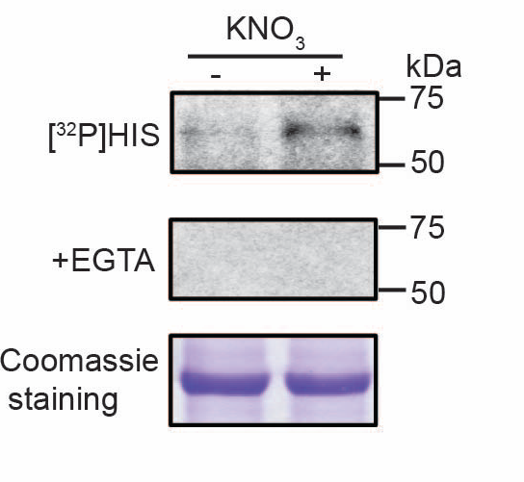
Unique Nitrate-Ca²⁺ Signaling
ultrasensitive Ca²⁺ biosensor GCaMP6s
Liu et al., Nature 2017
Notes:
Genetics, transgenic, genomics and systems biology in the past three decades. Primary signaling transceptor NRT1.1/NPF6.3, CHL1,
Transporters, transceptor & TFs systems biology, auquorin, chameleon, synthetic calcium indicator, not CIPKs
Here is the movie that shows nitrate induces calcium concentration change in cell. Nitrate induce calcium concentration change after 1 min induction and reach a peak at around 4 mins and then gradually decreasing. This fluorescence increasing can be blocked by the calcium chelator EGTA indicates this is a real calcium signaling. We also test another nitrogen source, ammonium, and different from nitrate, ammonium does not stimulate calcium concentration change. We also generated a transgenic line harboring this GCAMP6s. Similarly, nitrate induced calcium concentration changes in leaf mesophyll cell.

Slide 7
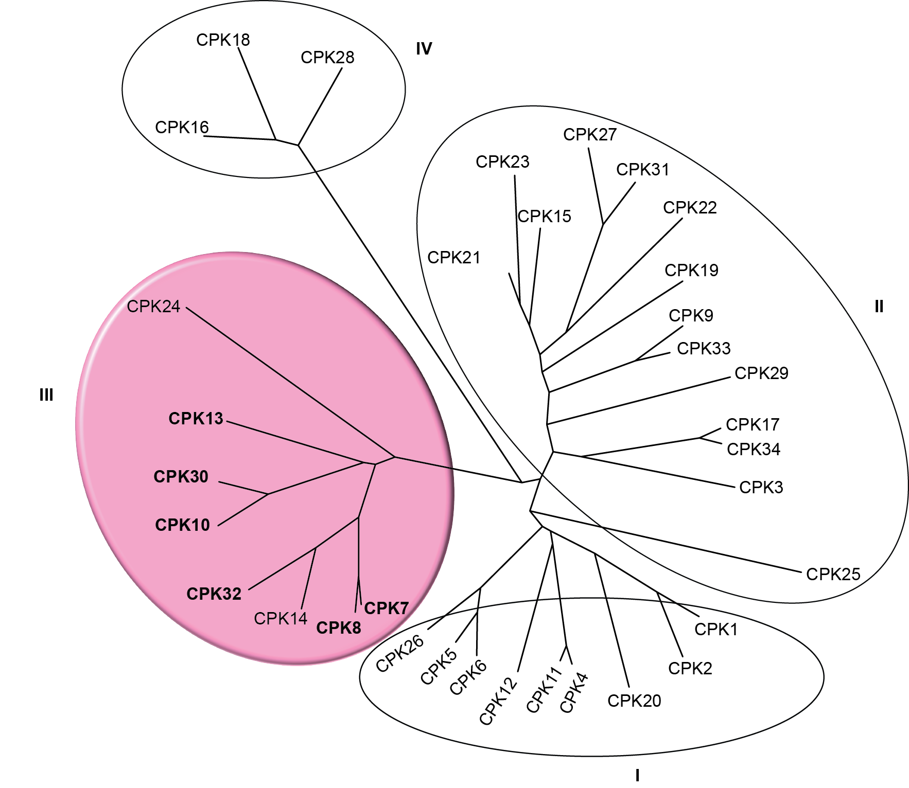
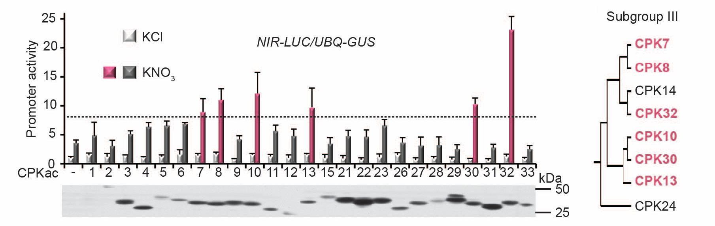
Ca²⁺ Sensor Protein Kinases in Nitrate Signaling
auto-inhibitor
EF-hand
N
kinase
III
CaM-like
constitutively active CPKs
Liu et al., Nature 2017
Notes:
Now Go back to calcium. There are two type of calcium sensor protein kinases. First one is CIPK. This CIPK can not sense calcium. It needs to interact with a calcium sensor CBL. When Calcium bind to ef hand calcium binding domain it will interact with CIPK and activate its kinase activity. Another one is CPK. This protein kinase has a camodulin like C-terminal that can direct bind to calcium and activate its kinase activity. According to my previous study, nitrate induces an around 65 kd protein kinase. CPK encodes around 65 KN protein kinases So I wonder whether theseCPKs are involved in nitrate signaling.

Slide 8
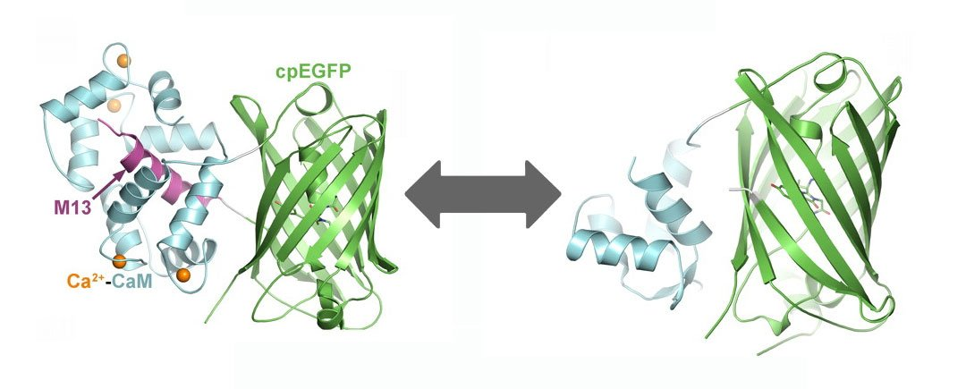
The NO₃⁻-Ca²⁺-CPK-NLP7 Relay in Nitrate Signaling
NO₃⁻
Sensors ?
CHL1-independent
GCaMP6s
CPK nuclear entry & activation
Inducible cpk10,30,32 triple mutant
p-NLP7 phosphorylation & nuclear retention
Transcription activation
Ca²⁺
Ca²⁺
Sensors
CPK10,30,32
P
NIR
NIA1/2
NRT2.1
NLP7
NRE
Nitrate responsive gene
NRE: Nitrate Response Elements
Notes:
Now, I have showed you that CPK regulate nitrate responsive gene expression through NLP and NRE. The next question is how CPK regulate NLP activity.

Slide 9
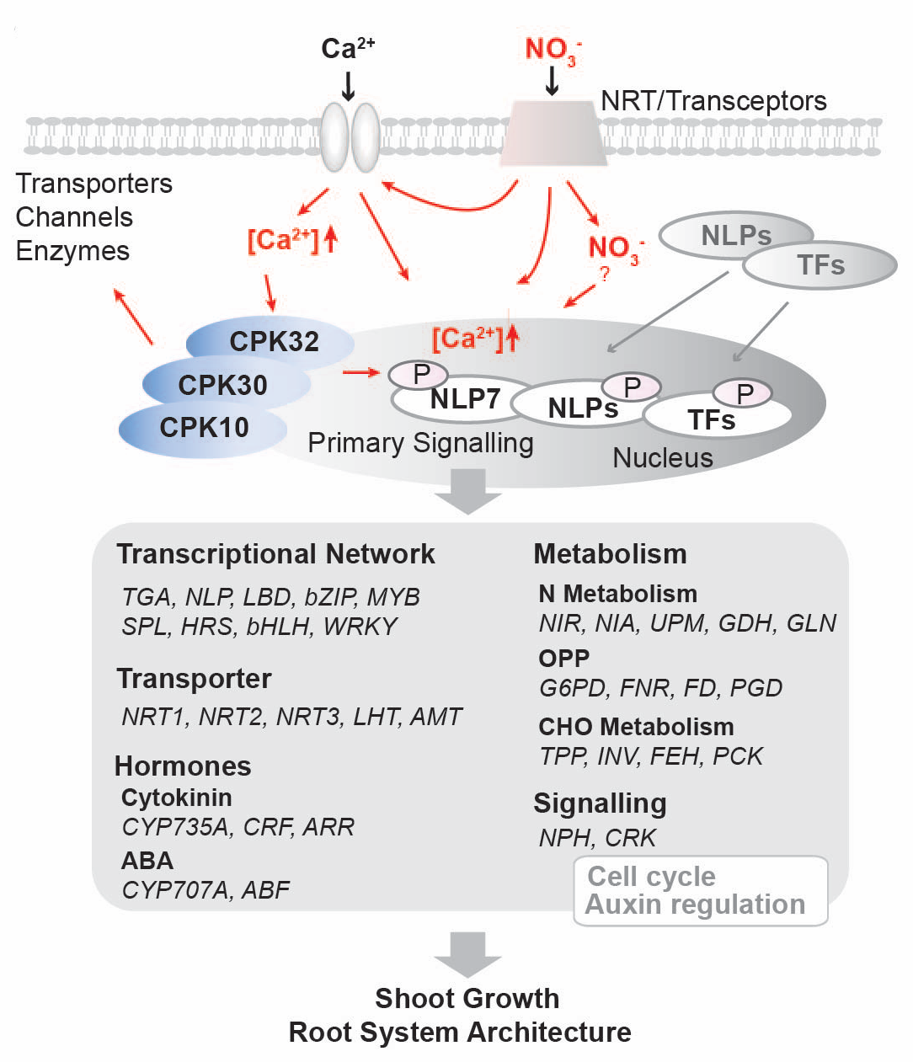
The Nitrate-CPK-NLP Signaling Network
?
Liu et al., Nature 2017

Slide 10
Nitrate Sensors in Nitrate Signaling

Slide 11
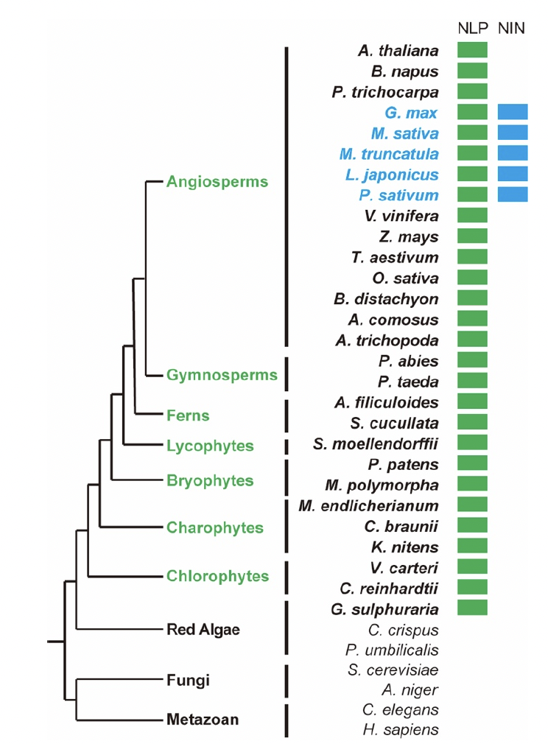
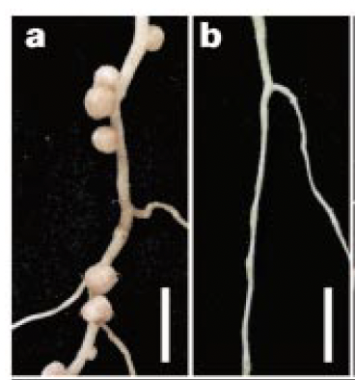
NLP Transcription Factors
Lotus
WT
nin
NIN: NODULE INCEPTION
Schauser et al., 1999
Land Plants
Nodule formation
S205
NLP : NIN-Like Protein
GAF
?
RWP
PB1
~110 kD
GAF: Putative small molecule binding domain
RWP: DNA binding domain
PB1: protein-protein interaction domain
Castaings et al., 2009

Slide 12
NLP Transcription Factors
AtNLP8
AtNLP9
AtNLP5
AtNLP4
NO₃⁻
AtNLP3
PsNIN
AtNLP6
Ca²⁺
MtNIN
LjNIN
AtNLP2
AtNLP1
AtNLP7
CPK10,30,32
0.1
P
NLPs
NIR
NIA1/2
NRT2.1
NRE
Nitrate responsive gene
NRE: Nitrate Response Elements
(Konishi and Yanagisawa, 2013)
Notes:
There are 9 NLP members in Arabidopsis. It contains a RWP DNA binding domain that can bind to NRE. NLP1,2,4,6,7 are expressed in the root and shoot.

Slide 13
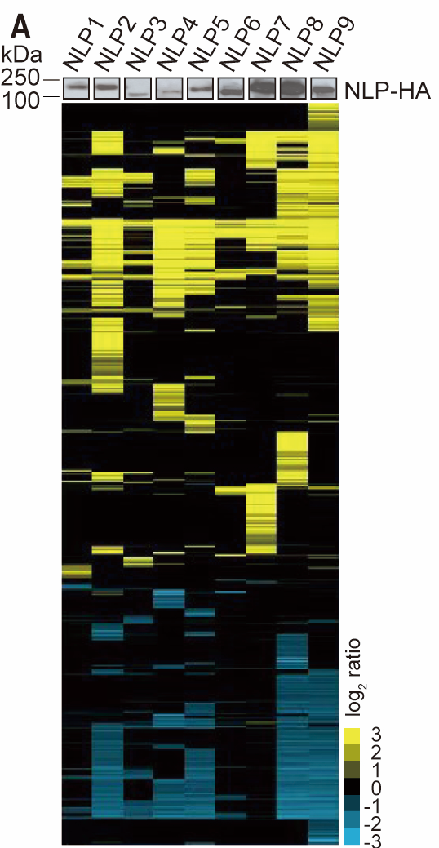

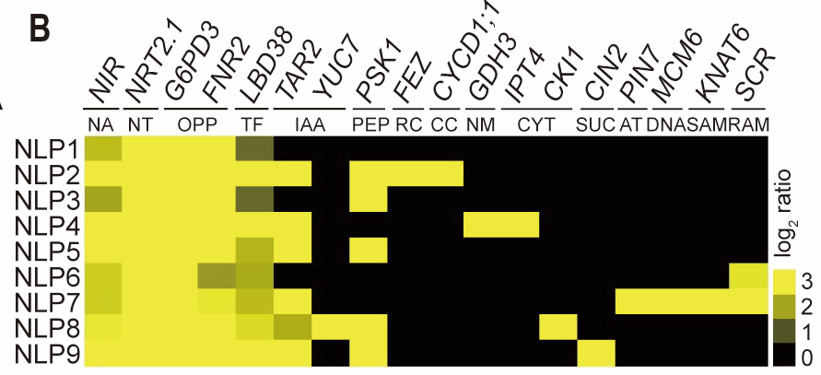
NLPs Regulate Both Common and Distinct Genes
Protoplasts from soil-grown plants
α-HA
NLP1
NLP2
NLP3
NLP4
NLP5
NLP6
NLP7
NLP8
NLP9
Primary nitrate-response
RNA-Seq analysis

Slide 14
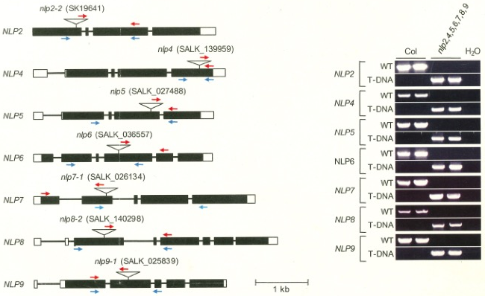
Isolation of the nlp2,4,5,6,7,8,9 Septuple Mutant
Konishi, Okitssu & Yanagisawa, JXB2021

Slide 15
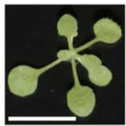
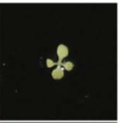
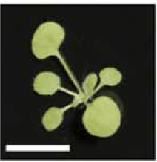
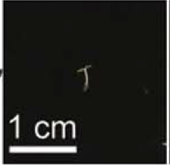
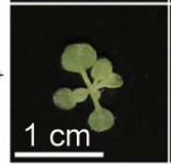
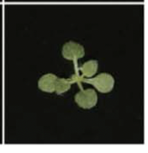
NLP TFs Control Nitrate-dependent
Shoot Development
Wild type
nlp2,4,5,6,7,8,9
Soil
Wild type
nlp2,4,5,6,7,8,9
NO₃⁻
Nitrate specific
NH₄⁺

Slide 16
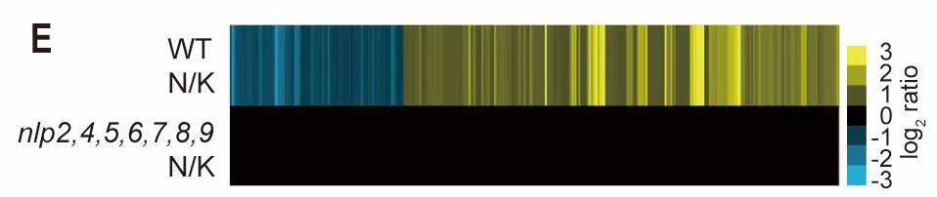
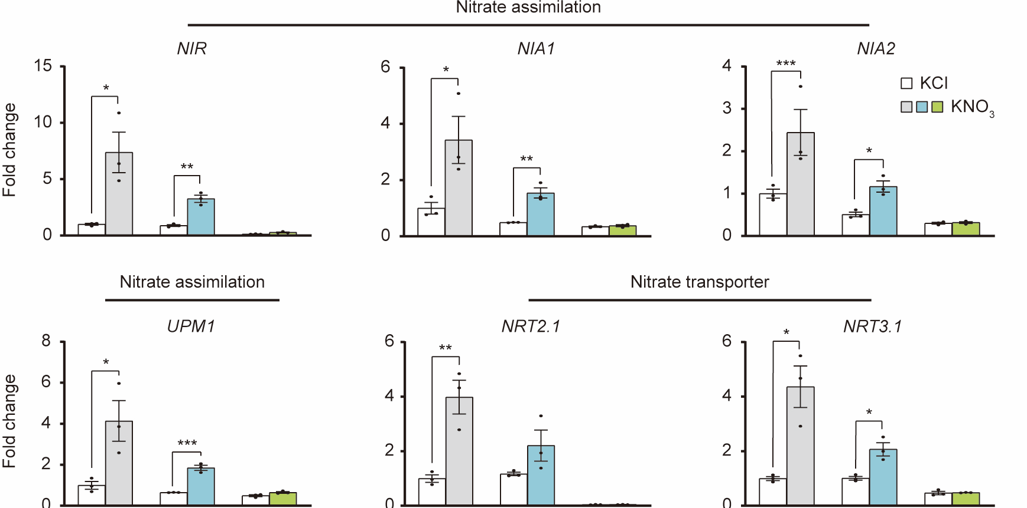
NLP TFs Are Master Regulators in Nitrate Signaling
WT
N/K
RNA-Seq
nlp2,4,5,6,7,8,9,
N/K
NIR
NIA1
NIA2
Fold Change
UPM1
NRT2.1
NIRT3.1
Fold Change
WT
chl1-5
nlp2,4,5,
6,7,8,9
WT
chl1-5
nlp2,4,5,
6,7,8,9
WT
chl1-5
nlp2,4,5,
6,7,8,9

Slide 17
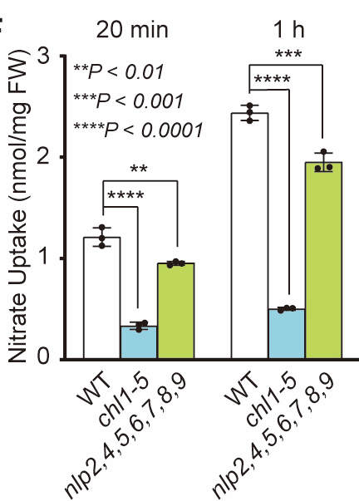
The Uptake of Nitrate is Moderately Reduced
in nlp2,4,5,6,7,8,9
Nitrate uptake

Slide 18
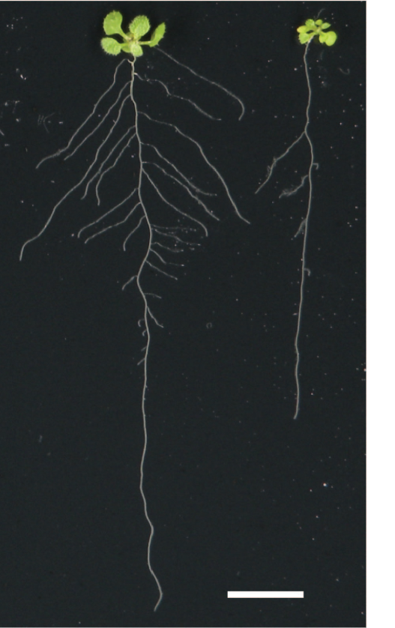
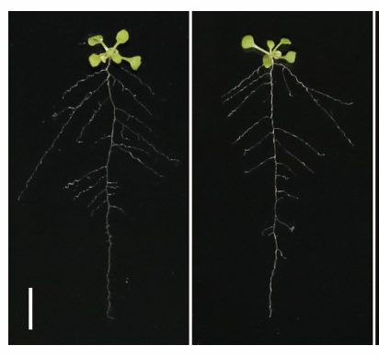
chl1-5 Resembles WT in Response to Nitrate
NO₃⁻
CHL1
CHL1: Nitrate transporter/sensor
NO₃⁻
Signaling
NO₃⁻
-
NO₃⁻
Wild type
icpk
Wild type
nlp7-1
Wild type
chl1-5

Slide 19
Nitrate Sensors Other Than CHL1 ?

Slide 20
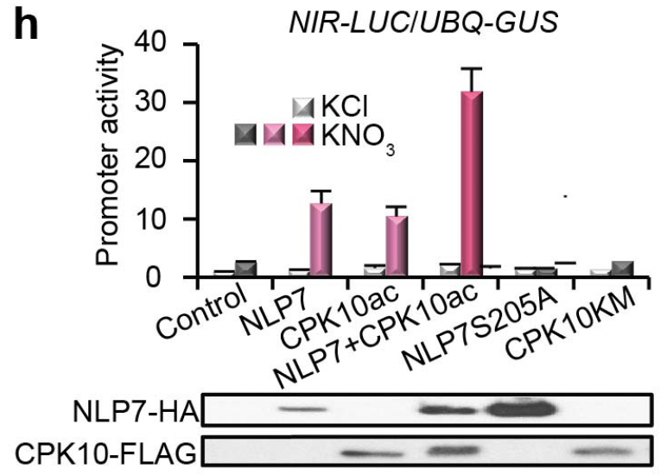
NIR-LUC Activation Requires CPK & Nitrate
Effector
35S
NLP7
HA
35S
CPK10ac
FLAG
Reporter
NIR
Luciferase
Liu et al., Nature 2017

Slide 21
The Transcriptional Activity of NLP7 Is Nitrate-Dependent
Cell-based assay
NO₃⁻
NLP7
NRE-LUC/RLUC
NO₃⁻
Promoter activity
NLP7
Luciferase
4X NRE
-
+NO₃⁻
-
+NO₃⁻
-NLP7
+NLP7
Nitrate-free nlp2,4,5,6,7,8,9 protoplasts

Slide 22
The N-terminus of NLP6 Is Important for Nitrate Response
The nitrate response domain
NLP6
GAF
?
RWP
PB1
GAF
?
LexA
NLS
Artificial DNA binding
N-NLP6-LexA
NO₃⁻
KCl
KNO₃
NLP6
LexA
GUS
8X LexA
Konishi and Yanagisawa, NC2013

Slide 23
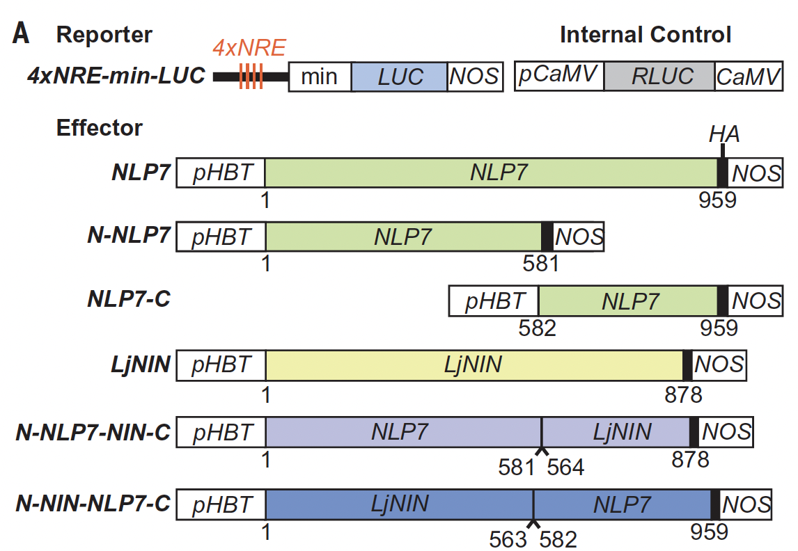
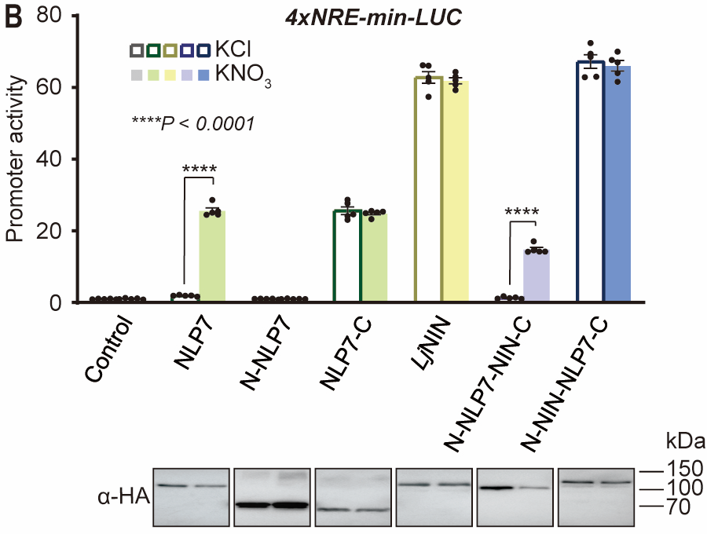
Nitrate Derepresses NLP7
GAF
?
RWP
PB1
Nitrate-free nlp2,4,5,6,7,8,9 protoplasts
NLP7

Slide 24
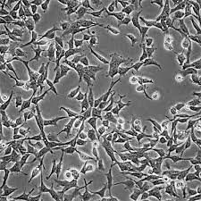
Reconstitution of Nitrate-NLP7 Transcriptional Activity in HEK293T Cells
Promoter activity
HEK293 cells
NO₃⁻
NLP7
NO₃⁻
-
+NO₃⁻
-
+NO₃⁻
NLP7
-NLP7
+NLP7
Luciferase
4X NRE
HEK293T cells
Heterologous human cell system

Slide 25
NLP7 Binds to Nitrate ?
NO₃⁻
?
NO₃⁻
GAF
?
RWP
PB1
NLP7

Slide 26
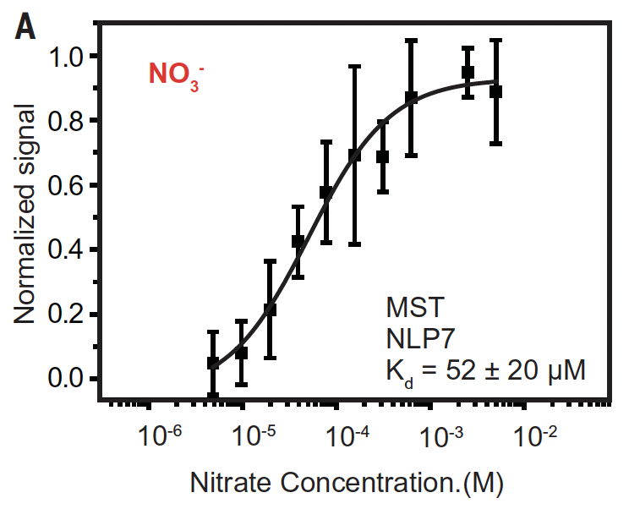
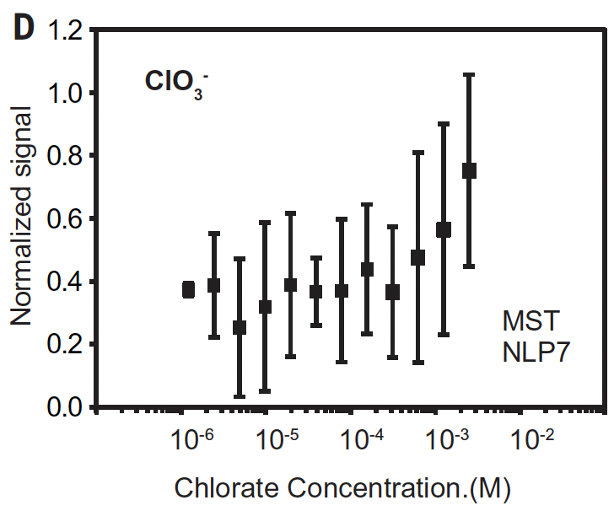
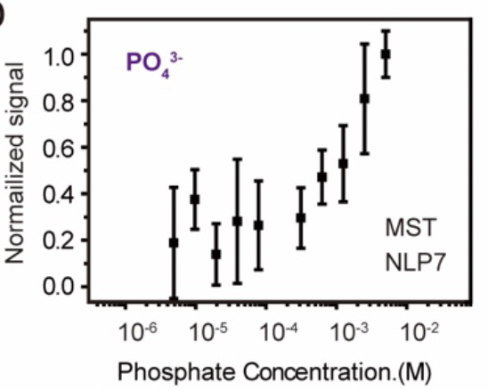
NLP7 Binds to Nitrate
Microscale thermophoresis (MST)

Slide 27
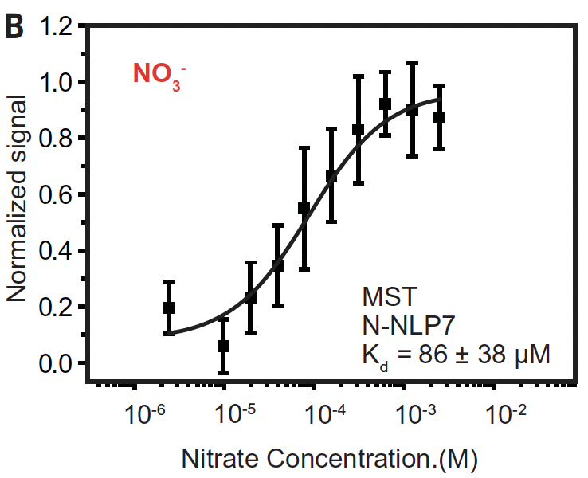
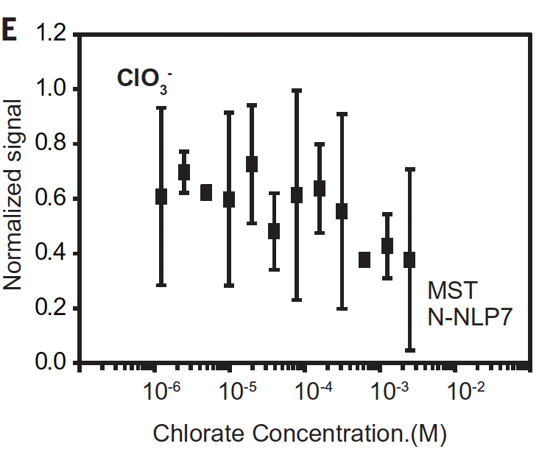
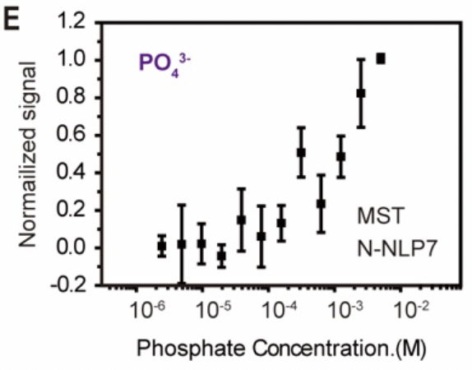
The N-terminus of NLP7 Binds to Nitrate
Microscale thermophoresis (MST)

Slide 28
The N-terminus of NLP7 Binds to Nitrate
NLP7 (1-581)
Kd=72 ± 34 μM
Surface Plasmon Resonance

Slide 29
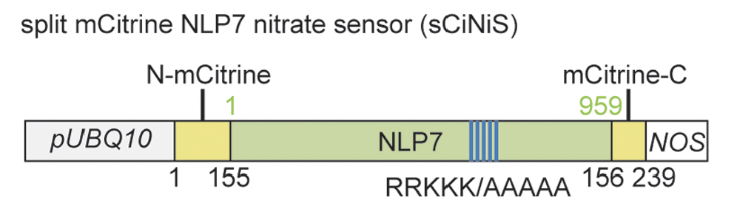
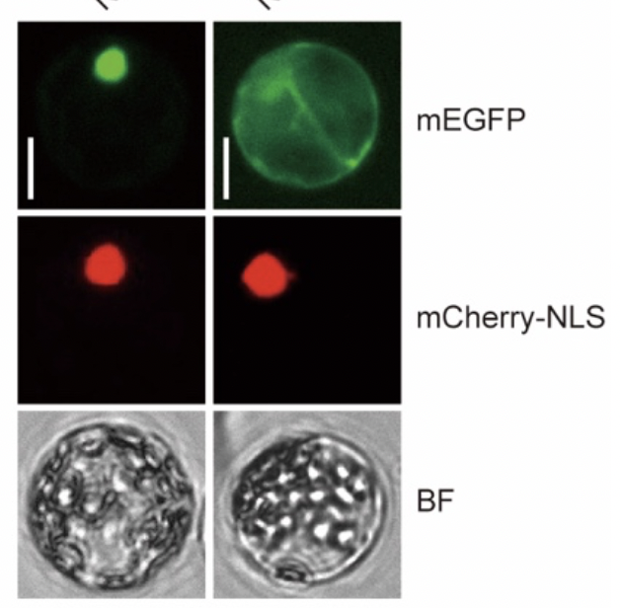
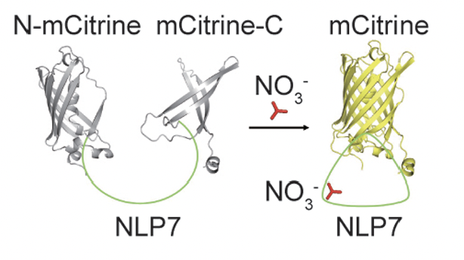
Split mCitrine NLP7 Nitrate Sensor for Detecting NLP7-Nitrate Binding
NLP7(RRKKK/AAAAA)
-GFP
NLP7-GFP
Zhiwei Lin & Binqing Chen

Slide 30
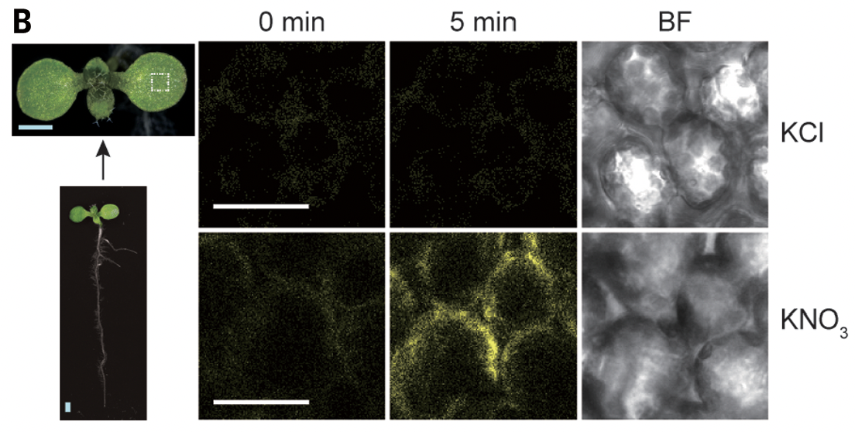
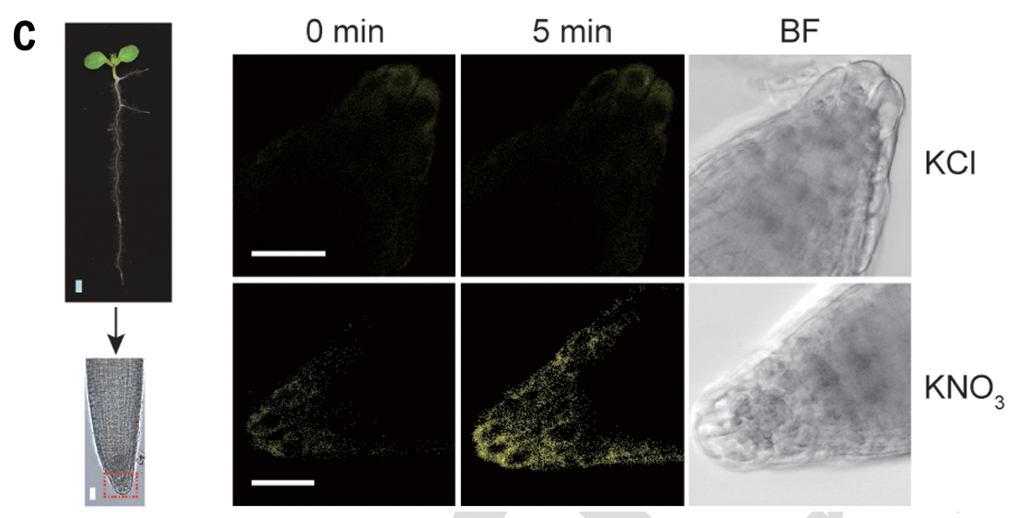
sCiNiS Detects Nitrate At a Single-cell Resolution

Slide 31
NreA Is a Nitrate Sensor in Staphylococcus
NreA-NreB-NreC : -O₂ /NO₃⁻ sensing
GAF: cGMP-specific phosphodiesterase, Adenylyl cyclase, FhlA
NreA
GAF
NreB
HK,O₂ sensor
NreA
NO₃⁻ sensor
NreA
NreC
TF
P
NreB
NreA
NO₃⁻
Anaerobic
Niemann et al., 2014
Unden et al., 2021

Slide 32
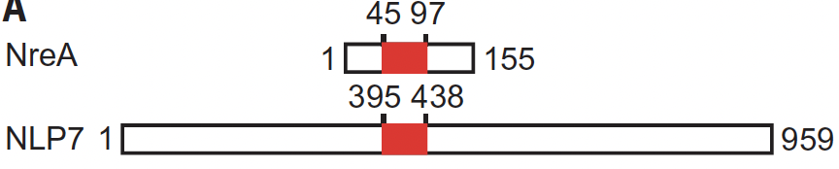
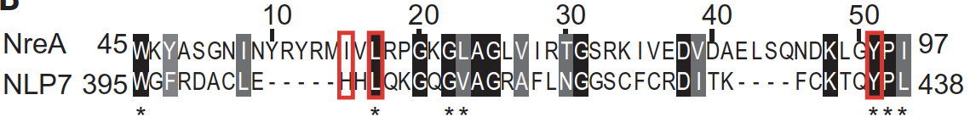
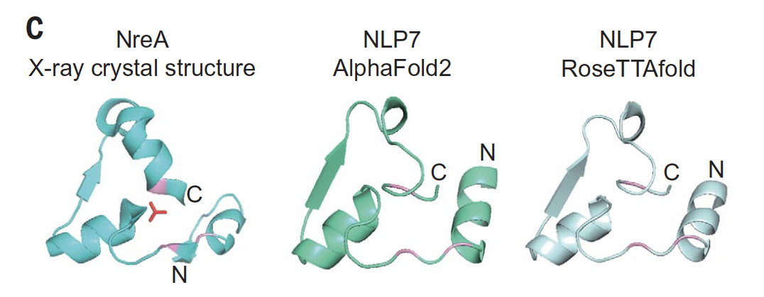
The Nitrate Binding Pockets in NLP7 & NreA Are Similar

Slide 33
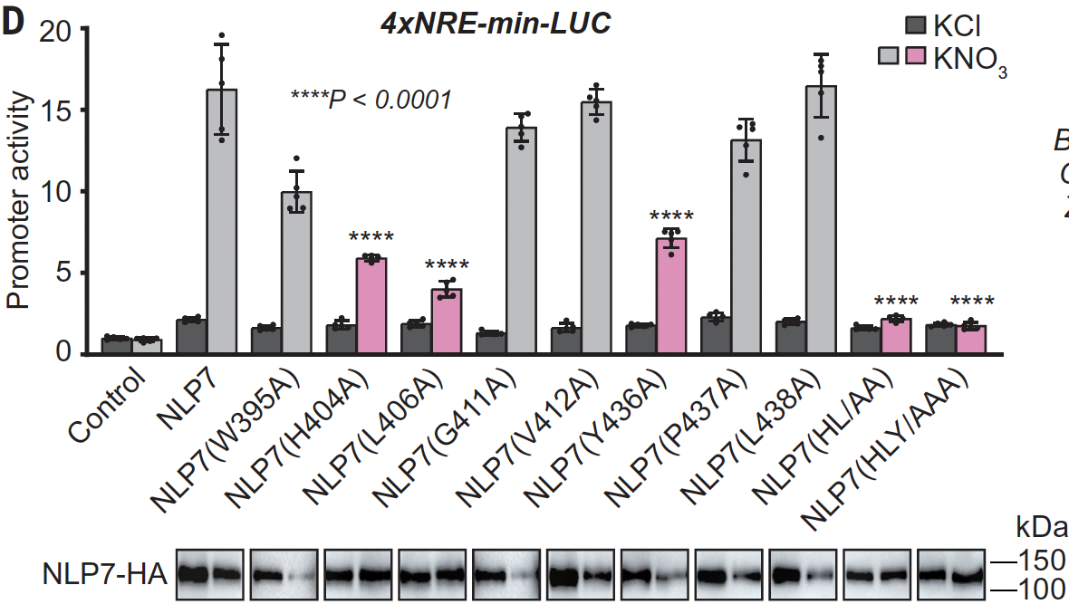
The Residues H404, L406, Y436 of NLP7
Are Important for NLP7 TF Activity

Slide 34
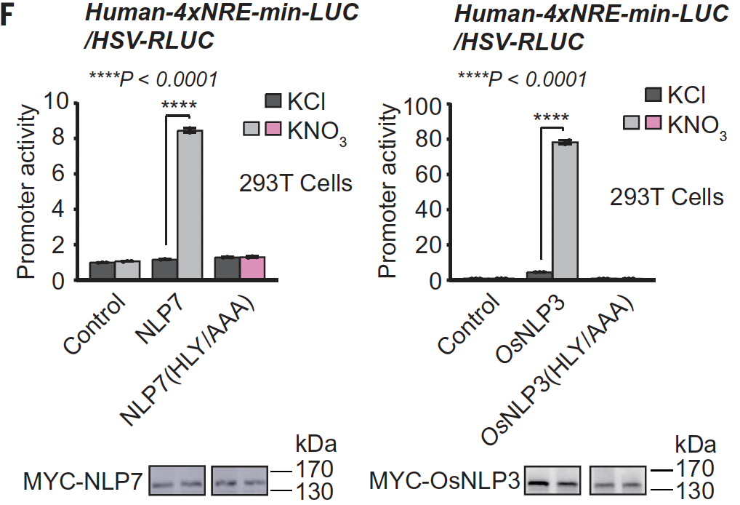
The Residues H404, L406, Y436 of NLP7 and OsNLP3 Are Important for Nitrate Response in Human Cells
Heterologous system

Slide 35
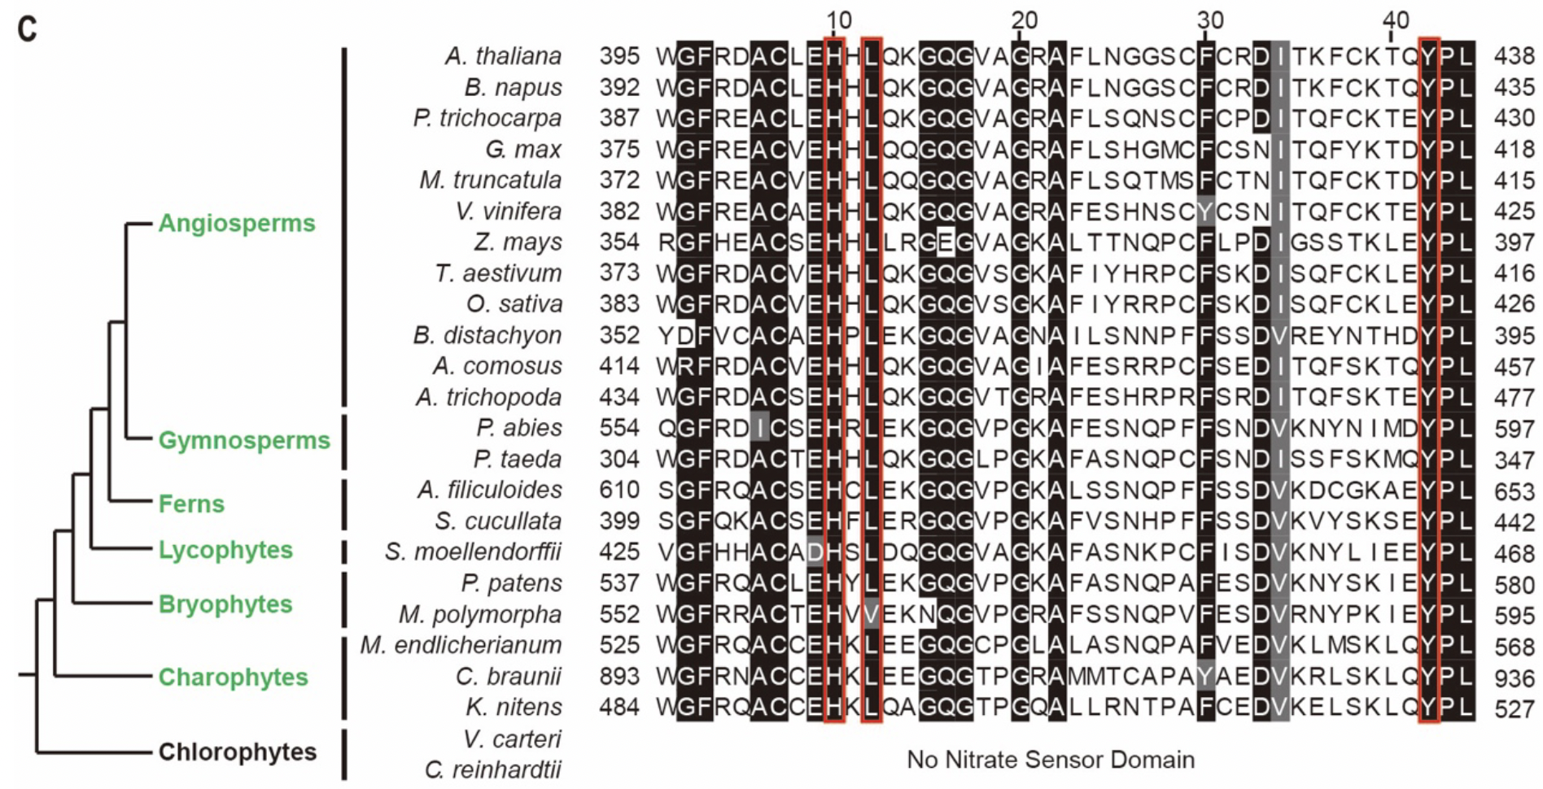
The Nitrate-binding Domain is Conserved in Other NLPs and NLP7 Orthologs of Land Plants and Charophytes

Slide 36
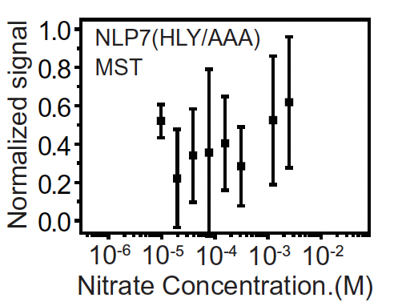
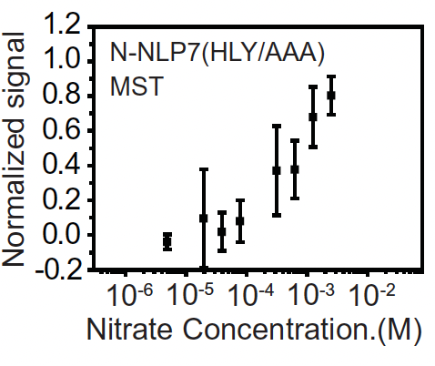
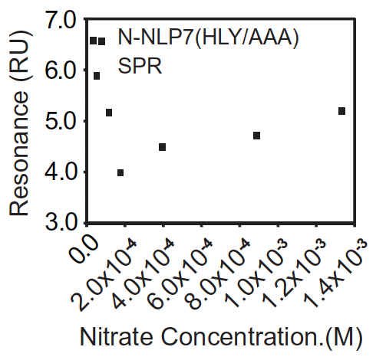
The Residues H404, L406, Y436 of NLP7
Are Important for Nitrate Binding
NLP7(HYL/AAA)
N-NLP7(HYL/AAA)
N-NLP7(HYL/AAA)
Microscale thermophoresis (MST)
Surface Plasmon Resonance

Slide 37
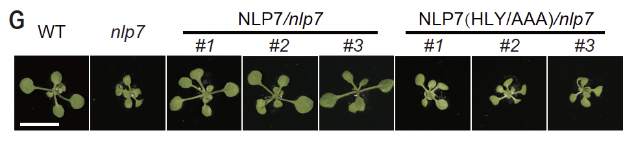
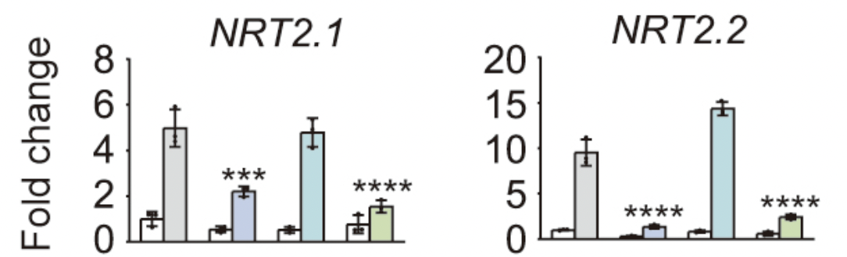
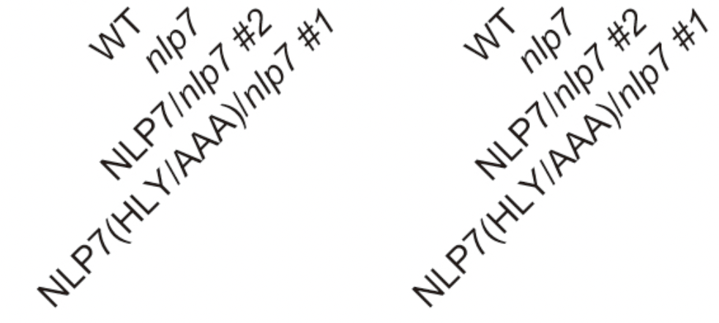
The Nitrate-Binding Mutant Cannot Complement nlp7
Complementation
Analysis

Slide 38
Summary
NO₃⁻
Ca²⁺
NLP transcription factors are master regulators in nitrate signaling
2. Combinatorial functions of NLPs are central
to primary nitrate responses
3. NLP7 plays a predominant role in nitrate
signaling and is conserved in crop plants
4. Nitrate binding derepresses NLP7
5. sCiNiS detects nitrate binding
6. The Residues H404, L406, Y436 of NLP7 are
important for NLP7 function
7. Mutation of H404, L406, Y436 in NLP7
eliminates nitrate binding & signaling
CHL1/NRT
=
?
NO₃⁻
[Ca²⁺]
Ca²⁺
CPKs
NLP7
NO₃⁻
0
P
nucleus
NLP7
CPKs
NRE
Nitrate responsive gene
NIR, NIA1, NRT2.1, LBD, FNR, G6PD
Nitrate response genes
Diverse physiological functions & processes
Shoot & lateral root morphogenesis

Slide 39


Acknowledgment
Massachusetts General Hospital
Jen Sheen
Matthew McCormack
Jenifer Bush
Northwest Agriculture &
Forestry University, China
MengHong Liu
BinQin Chen
Zhiwei Lin
Chong Liu
Aping Guo
BCMP-HMS
Zhi-Fu Wang
Gerhard Wagner
The University of Tokyo, Japan
Mineko Konishi
Shuichi Yanagisawa
Funding:

